Slide 1
Multidisciplinary Projects
Class 2: Requirements

Slide 2
Agenda
Learning Objectives
Introduction to Requirement Analysis
Use Case Diagram

Slide 3
Learning Objectives
Understanding the requirement Scenarios and use cases.
Understanding the models for requirements analysis and specification.

Slide 4
Requirements
Requirements deﬁne the function of the system from the client's viewpoint.
The requirements establish the system's functionality, constraints, and goals by consultation with the client, customers, and users.
The requirements may be developed in a self-contained study, or may emerge incrementally.
The requirements form the basis for acceptance testing.

Slide 5
Requirements
The development team and the client need to work together closely during the requirements phase of a software project.
The requirements must be developed in a manner that is understandable by both the client and the development staﬀ.

Slide 6
Why are Requirements Important?
Causes of failed software projects
Incomplete requirements 13.1%
Lack of user involvement 12.4%
Lack of resources 10.6%
Unrealistic expectations 9.9%
Lack of executive support 9.3%
Changing requirements & speciﬁcations 8.8%
Lack of planning 8.1%
System no longer needed 7.5%
Failures to understand the requirements led the developers to build the wrong system.

Slide 7
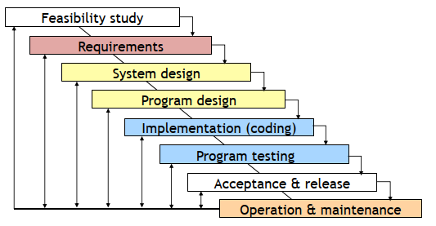
Requirements in the Modified Waterfall Model

Slide 8
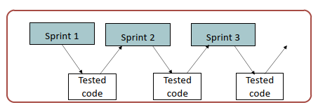
Requirements with Agile Development

Slide 9
Requirement Goals
Understand the requirements in appropriate detail.
Deﬁne the requirements in a manner that is clear to the client. This may be a written speciﬁcation, prototype system, or other form of communication.
Deﬁne the requirements in a manner that is clear to the people who will design, implement, and maintain the system.
Ensure that the client and developers understand the requirements and their implications.

Slide 10
Steps in the Requirements Phase
The requirements part of a project can be divided into several stages:
Analysis to establish the system's services, constraints, and goals by consultation with client, customers, and users.
Modeling to organize the requirements in a systematic and comprehensible manner.
Deﬁne, record, and communicate the requirements.

Slide 11
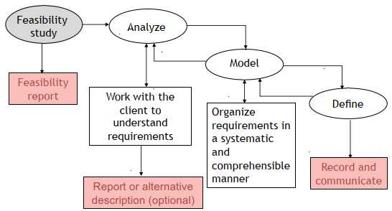
The Requirements Process

Slide 12
Interviews with Clients
Client interviews are the heart of the requirements analysis.
Clients may have only a vague concept of requirements.
Allow plenty of time.
Prepare before you meet with the client.
Keep full notes.
If you do not understand, delve further, again and again.
Repeat what you hear.
For your projects you will need to schedule several meetings with your client to analyze the requirements.
Small group meetings are often most eﬀective.

Slide 13
Understand the Requirements
Understand the requirements in depth
Domain understanding
Example: Manufacturing light bulbs
Understanding of the real requirements of all stakeholders
Stakeholders may not have clear ideas about what they require, or they may not express requirements clearly. They are often too close to the old way of doing things.
Understanding the terminology
Clients often use specialized terminology. If you do not understand it, ask for an explanation.
Keep asking questions, “Why do you do things this way?” “Is this essential?” “What are the alternatives?”

Slide 14
New and Old Systems
A new system is when there is no existing system. This is rare.
A replacement system is when a system is built to replace an existing system.
A legacy system is an existing system that is not being replaced, but must interface to the new system.
Clients often confuse the current system with the underlying requirement.
In requirements analysis it is important to distinguish:
features of the current system that are needed in the new system
features of the current system that are not needed in the new system
proposed new feature

Slide 15
Unspoken Requirements
Discovering the unspoken requirements is often the most diﬃcult part of developing the requirements.
Examples:
Resistance to change
Departmental friction (e.g., transfer of staff)
Management strengths and weaknesses

Slide 16
Stakeholders
Identify the stakeholders: Who is aﬀected by this system?
Client
Senior management
Production staﬀ
Computing staﬀ
Customers
Users (many categories)
etc., etc., etc.,
Example: web shopping site (shoppers, administration, ﬁnance, warehouse). SE projects that build web applications often ﬁnd that the administrative system that is not seen by the users is bigger than the part of the site that is visible to the users.

Slide 17
Viewpoint Analysis
Analyze the requirements as seen by each group of stakeholders.
Example: University Admissions System
Applicants
University administration
Admissions oﬃce
Financial aid oﬃce
Special oﬃces (e.g., athletics, development)
Academic departments
Computing staﬀ
Operations and maintenance

Slide 18
Special Studies
Market research
focus groups, surveys, competitive analysis, etc.
Example: Windows XP T-shirt that highlighted Apple’s strengths
Technical evaluation
experiments, prototypes, etc.
Example: Windows XP boot faster

Slide 19
Deﬁning and Communicating Requirements
Record agreement between clients and developers
Provide a basis for acceptance testing
Provide visibility
Be a foundation for system and program design
Communicate with other teams who may work on or rely on this system
Inform future maintainers

Slide 20
Deﬁning and Communicating Requirements-Realism and Veriﬁability
Requirements must be realistic, i.e., it must be possible to meet them.
Wrong: The system must be capable of x.
Right: The computer system can do x at a reasonable cost.
Requirements must be verifiable, i.e., since the requirements are the basis for acceptance testing, it must be possible to test whether a requirement has been met.
Wrong: The system must be easy to use.
Right: After one day's training an operator should be able to input 50 orders per hour.

Slide 21
Deﬁning and Communicating Requirements: Option 1-Heavyweight Processes
Heavyweight software processes expect detailed speciﬁcation
Written documentation that speciﬁes each requirement in detail.
Carefully checked by client and developers.
May be a contractual document.

Slide 22
Deﬁning and Communicating Requirements: Option 1-Heavyweight Processes
Diﬃculties
Time consuming and diﬃcult to create.
Time consuming and diﬃcult to maintain.
Checking a detailed speciﬁcation is diﬃcult and tedious.
Details may obscure the overview of the requirements.
Clients rarely understand the implications.
The diﬃculty of creating and maintaining a detailed requirements speciﬁcation is one of the reasons that many organizations are attracted to lighter weight development processes.

Slide 23
Deﬁning and Communicating Requirements: Option 2-Lightweight Processes
Lightweight processes use an outline specification + other tools
Documentation describing key requirements in appropriate detail.
Reviewed by client and developers.
Details provided by supplementary tools, e.g.,
User interface mock-up or demonstration.
Models, e.g., data base schema, state machine, etc.
Clients understand prototypes and models better than specification
Iterative or incremental (agile) development processes allows the client to appreciate what the final system will do.

Slide 24
Deﬁning and Communicating Requirements: Option 2-Lightweight Processes
With lightweight processes, experience and judgment are needed to distinguish between details that can be left for later in the development process and key requirements that must be agreed with the client early in the process.
Examples where detailed speciﬁcations are usually needed
Business rules (e.g., reference to an accounting standard)
Legal restraint (e.g., laws on retention of data, privacy)
Data ﬂow (e.g., sources of data, data validation)
A common fault is to miss crucial details. This results in misunderstandings between the client and the developers.
Yet the whole intent of lightweight processes is to have minimal intermediate documentation.

Slide 25
Functional Requirements
Functional requirements describe the functions that the system must perform. They are identiﬁed by analyzing the use made of the system and include topics such as:
Functionality
Data
User interfaces

Slide 26
Non-Functional Requirements
Requirements that are not directly related to the functions that the system must perform
Product requirements
performance, reliability, portability, etc...
Organizational requirements
delivery, training, standards, etc...
External requirements
legal, interoperability, etc...
Marketing and public relations

Slide 27
Functional vs. Nonfunctional Requirements
A functional requirement describes what a software system should do, while non-functional requirements place constraints on how the system will do so.
Functional requirement would be:
A system must send an email whenever a certain condition is met (e.g. an order is placed, a customer signs up, etc).
A related non-functional requirement for the system may be:
Emails should be sent with a latency of no greater than 5 hours from such an activity.

Slide 28
Requirements Confliction
Some requests from the client may conﬂict with others:
Recognize and resolve conﬂicts (e.g., functionality vs. cost vs. timeliness)
Example:
Windows XP boot faster: shorter time-out vs. recognize all equipment on bus

Slide 29
Negotiation with the Client
Sometimes the client will request functionality that is very expensive or impossible. What do you do?
Talk through the requirement with the client. Why is it wanted? Is there an alternative that is equivalent?
Explain the reasoning behind your concern. Explain the technical, organizational, and cost implications.
Be open to suggestions. Is there a gap in your understanding? Perhaps a second opinion might suggest other approaches.
Before the requirements phase is completed the client and development team must resolve these questions.

Slide 30
Scenarios
A scenario is a scene that illustrates some interaction with a proposed system.
A scenario is a tool used during requirements analysis to describe a specific use of a proposed system. Scenarios capture the system, as viewed from the outside, e.g., by a user, using specific examples.
Note on terminology
Some authors restrict the word “scenario” to refer to a user’s total interaction with the system.
Other authors use the word “scenario” to refer to parts of the interaction.
In this course, the term is used with both meanings.

Slide 31
Describing a Scenario
Some organizations have complex documentation standards for describing a scenario.
At the very least, the description should include:
A statement of the purpose of the scenario
The individual user or transaction that is being followed through the scenario
Assumptions about equipment or software
The steps of the scenario

Slide 32
Developing a Scenario with a Client
The requirements are being developed for a system that will enable university students to take exams online from their own rooms using a web browser.
Create a scenario for how a typical student interacts with the system

Slide 33
Developing a Scenario with a Client (cont.)
Purpose: Scenario that describes the use of an online Exam system by a representative student
Individual: [Who is a typical student?] Student A, senior at VGU, major in IT. [Where can the student be located? Do other universities differ?]
Equipment: Any computer with a supported browser. [Is there a list of supported browsers? Are there any network restrictions?]
1. Student A authenticates. [How does an VGU student authenticate?]
2. Student A starts browser and types URL of Exam system. [How does the student know the URL?]
3. Exam system displays list of options. [Is the list tailored to the individual user?]

Slide 34
Developing a Scenario with a Client (cont.)
4. Student A selects Exam 1.
5. A list of questions is displayed, each marked to indicate whether completed or not. [Can the questions be answered in any order?]
6. Student A selects a question and chooses whether to submit a new answer or edit a previous answer. [Is it always possible to edit a previous answer? Are there other options?]
7. [What types of question are there: text, multiple choice, etc.?] The first question requires a written answer. Student A is submitting a new answer. The student has a choice whether to type the solution into the browser or to attach a separate file. Student A decides to attach a file. [What types of file are accepted?]

Slide 35
Developing a Scenario with a Client (cont.)
8. For the second question, the student chooses to edit a previous answer. Student A chooses to delete a solution previously typed into the browser, and to replace it with an attached file. [Can the student edit a previous answer, or must it always be replaced with a new answer?]
9. As an alternative to completing the entire exam in a single session, Student A decides to saves the completed questions to continue later. [Is this always permitted?]
10. Student A logs off.
11. Later Student A log in, finishes the exam, submits the answers, and logs out. [Is this process any different from the initial work on this exam?]

Slide 36
Developing a Scenario with a Client (cont.)
12. Student A has now completed the exam. The student selects an option that submits the exam to the grading system. [What if the student has not attempted every question? Is the grader notified?]
13. Student A now wishes to change a solution. The system does not permit changes once the solution has been submitted. [Can the student still see the solutions?]
14. Later Student A logins in to check the grades. [When are grades made available? How does the student know?]
15. Student A requests a regrade. [What are the policies? What are the procedures?]

Slide 37
Modeling Scenarios as Use Cases
Scenarios are useful in discussing a proposed system with a client, but requirements need to be made more precise before a system is fully understood.
This is the purpose of requirements modeling.
A use case provides such a model.

Slide 38
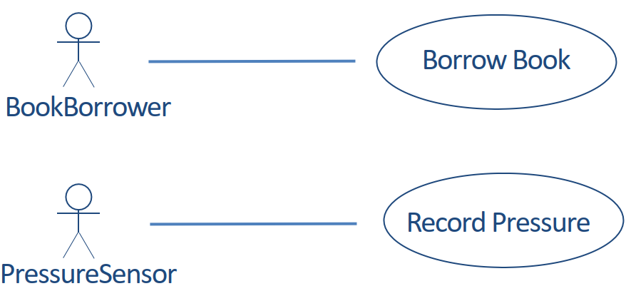
Two Simple Use Cases

Slide 39
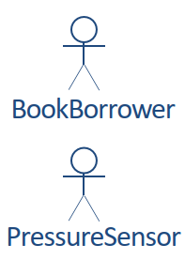
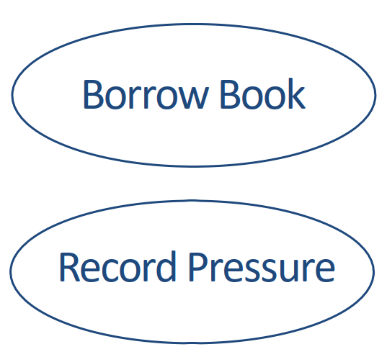
Actor and Use Case Diagram
An actor is a user of a system in a particular role.
An actor can be human or an external system.
A use case is a task that an actor needs to perform with the help of the system

Slide 40
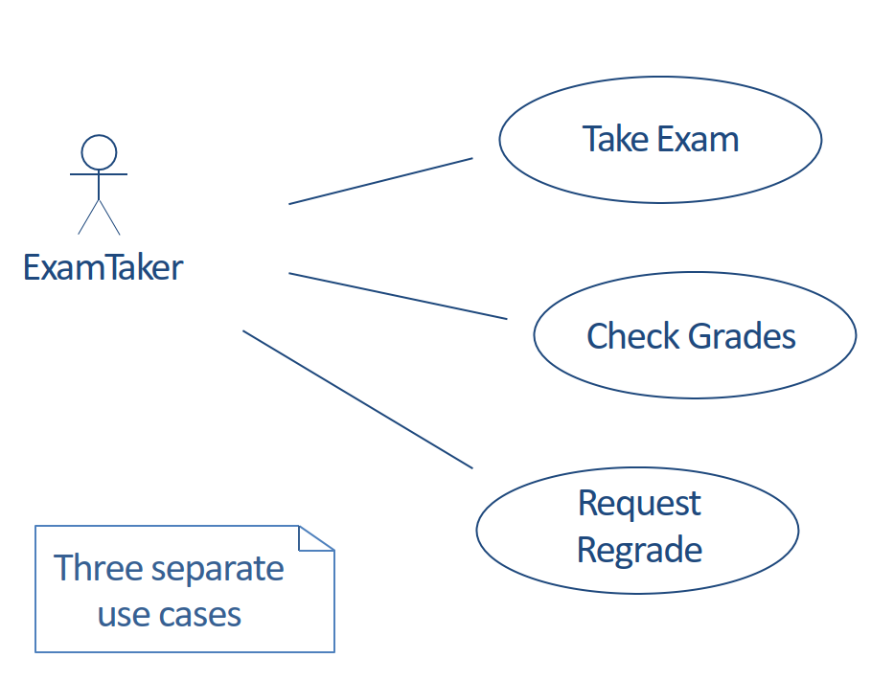
Use Cases for Exam System

Slide 41
Describing a Use Case
Some organizations have complex documentation standards for describing a use case.
At the very least, the description should include:
The name of the use case, which should summarize its purpose
The actor or actors
The flow of events
Assumptions about entry conditions

Slide 42
Outline of Take Exam Use Case
Name of Use Case: Take Exam
Actor(s): ExamTaker
Flow of events:
1. ExamTaker connects to the Exam server.
2. Exam server checks whether ExamTaker is already authenticated and runs authentication process if necessary.
3. ExamTaker selects a exam from a list of options.
4. ExamTaker repeatedly selects a question and either types in a solution, attaches a file with a solution, edits a solution or attaches a replacement file.

Slide 43
Outline of Take Exam Use Case (cont.)
5. ExamTaker either submits completed exam or saves current state.
6. When a completed exam is submitted, Exam server checks that all questions have been attempted and either sends acknowledgement to ExamTaker, or saves current state and notifies ExamTaker of incomplete submission.
7. ExamTaker logs out.
Entry conditions:
1. ExamTaker must have authentication credentials.
2. Computing requirements: supported browser.

Slide 44
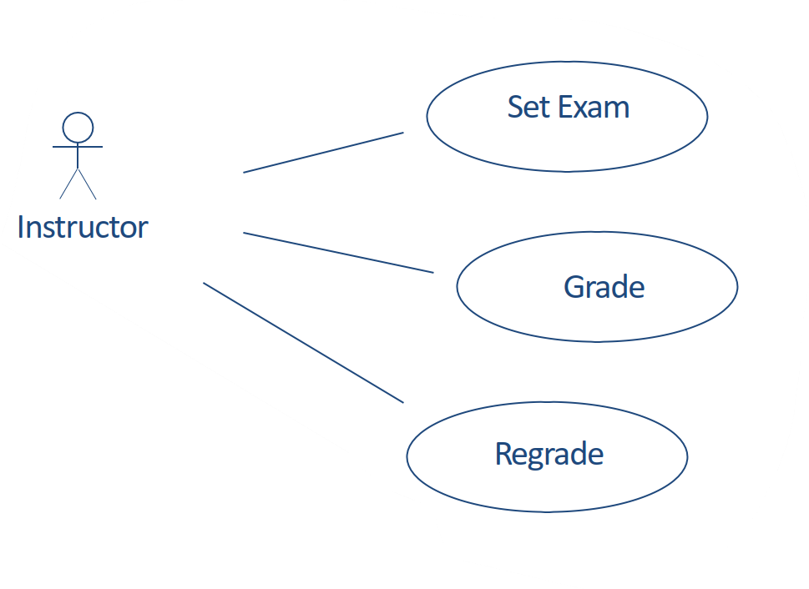
Outline of Take Exam Use Case (cont.)
Note that actor is a role. An individual can be an ExamTaker
on one occasion and an Instructor at a different time.

Slide 45
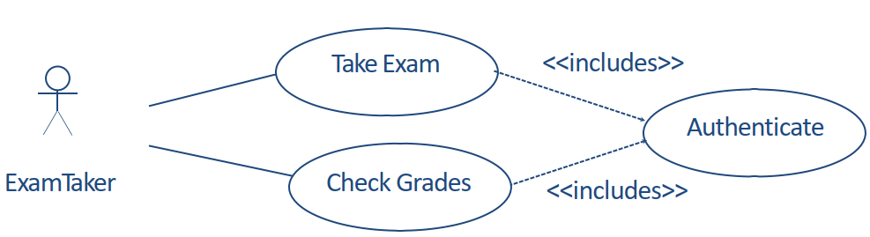
Relationships Between Use Cases: <<includes>>
<<includes>> is used for use cases that are in the flow of events of the main use case.

Slide 46
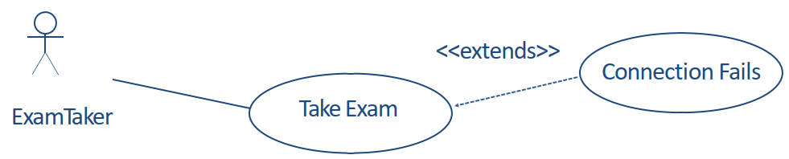
Relationships Between Use Cases: <<extends>>
<<extends>> is used for exceptional conditions,
especially those that can occur at any time.

Slide 47
Scenarios and Use Cases in the Development Cycle
Scenarios and use cases are both intuitive -- easy to discuss with clients
Scenarios are a tool for requirements analysis.
They are useful to validate use cases and in checking the design of a system.
They can be used as test cases for acceptance testing.
Use cases are a tool for modeling requirements.
A set of use cases can provide a framework for the requirements specification.
Use cases are the basis for system and program design, but are often hard to translate into class models.

Slide 48
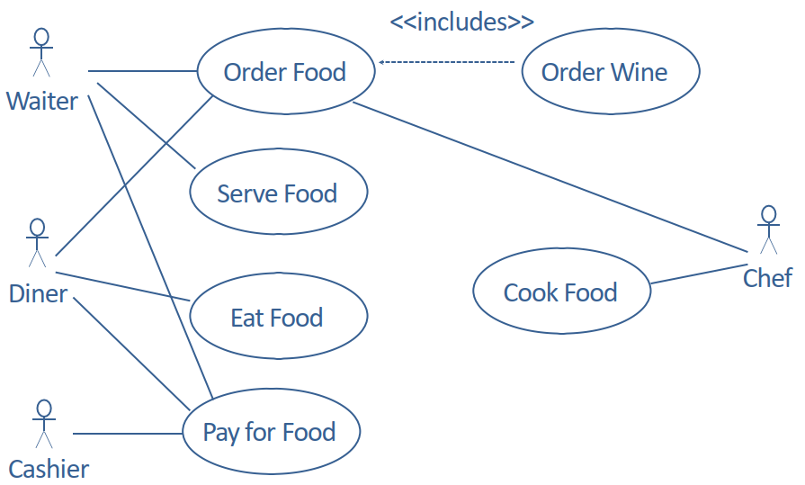
Use Cases with Several Actors

Slide 49
An Examination Question
The Pizza Ordering System
The Pizza Ordering System allows the user of a web browser to order pizza for home delivery. To place an order, a shopper searches to find items to purchase, adds items one at a time to a shopping cart, and possibly searches again for more items. When all items have been chosen, the shopper provides a delivery address. If not paying with cash, the shopper also provides credit card information. The system has an option for shoppers to register with the pizza shop. They can then save their name and address information, so that they do not have to enter this information every time that they place an order.

Slide 50
An Examination Question (cont.)
Develop a use case diagram, for a use case for placing an order, PlaceOrder. The use case should show a relationship to two previously specified use cases, IdentifyCustomer, which allows a user to register and log in, and PaybyCredit, which models credit card payments.

Slide 51
How to Draw a Use Case Diagram?
A Use Case model can be developed by following the steps below.
1. Identify the Actors (role of users) of the system.
2. For each category of users, identify all roles played by the users relevant to the system.
3. Identify what are the users required the system to be performed to achieve these goals.
4. Create use cases for every goal.
5. Structure the use cases.
6. Prioritize, review, estimate and validate the users.

Slide 52
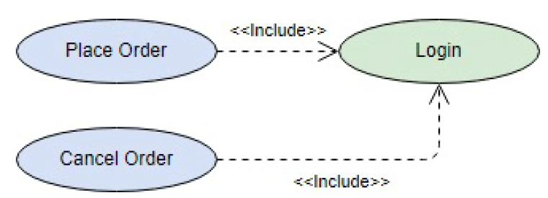
<<include>> Use Case
The time to use the <<include>> relationship is after you have completed the first cut description of all your main Use Cases. You can now look at the Use Cases and identify common sequences of user-system interaction.

Slide 53
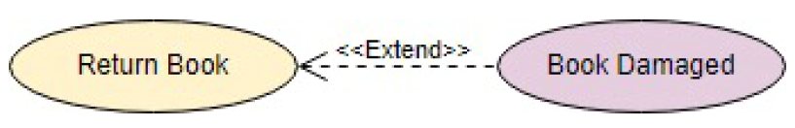
<<extend>> Use Case
An extending use case is, effectively, an alternate course of the base use case. The <<extend>> use case accomplishes this by conceptually inserting additional action sequences into the base use-case sequence.

Slide 54
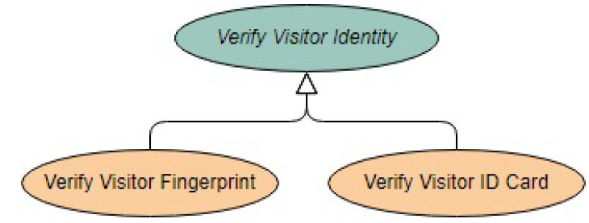
Abstract and Generalized Use Case
The general use case is abstract. It cannot be instantiated, as it contains incomplete information. The title of an abstract use case is shown in italics.

Slide 55
Models for Requirements Analysis and Specification
As you build understanding of the requirements through viewpoint analysis, scenarios, use cases, etc., use models to analyze and specify requirements. The models provide a bridge between the client's understanding and the developers'.
The craft of requirements analysis and specification includes selecting the appropriate tool for the particular task.
A variety of tools and techniques.
Many familiar from other courses.
No correct technique that fits all situations.

Slide 56
Models
A model is a simplification of reality
We build models so that we can better understand the system we are developing.
We build models of complex system because we cannot comprehend such a system in its entirety.
Models can be informal or formal. The more complex the project the more valuable a formal model becomes.

Slide 57
Principles of Modeling
The choice of what models to create has a profound influence on how a problem is attacked and how a solution is shaped.
No single model is sufficient. Every nontrivial system is best approached through a small set of nearly independent models.
Every model can be expressed at different levels of precision.
Good models are connected to reality.

Slide 58
The Unified Modeling Language (UML)
UML is a standard language for modeling software systems
Serves as a bridge between the requirements specification and the implementation.
Provides a means to specify and document the design of a software system.
Is process and programming language independent.
Is particularly suited to object-oriented program development.

Slide 59
Models: Diagrams and Specification in UML
In UML, a model consists of a diagram and a specification.
A diagram is the graphical representation of a set of elements, usually rendered as a connected graph of vertices (things) and arcs (relationships).
Each diagram is supported by technical documentation that specifies in more detail the model represented by the diagram.
A diagram without a specification is of little value.

Slide 60

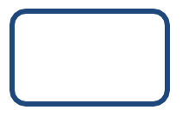


Data-Flow Models
An informal modeling technique to show the flow of data through a system
External entities
Processing steps
Data stores or sources
Data flows

Slide 61
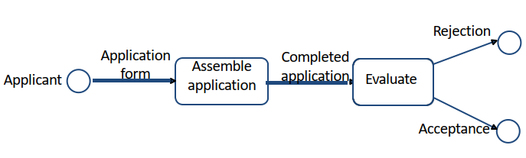
Data-Flow Model (cont.)
Example: University Admissions (first attempt)
Shows the flow, but where is the data stored? Is there supporting information?

Slide 62
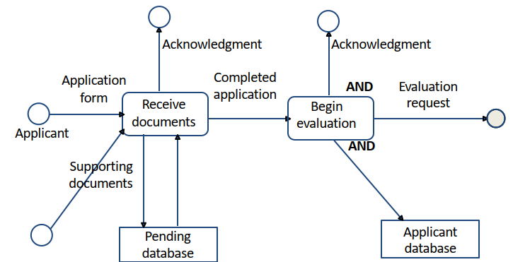
Data-Flow Model (cont.)
Example: Assemble Application
Does this model cover all situations?
Are there special cases?

Slide 63
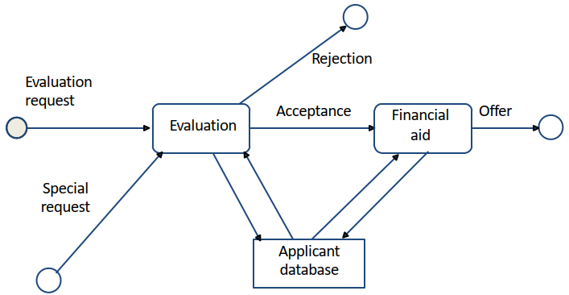
Data-Flow Model (cont.)
Example: Process Completed Application
The requirements will need a description of the decision-making process.

Slide 64
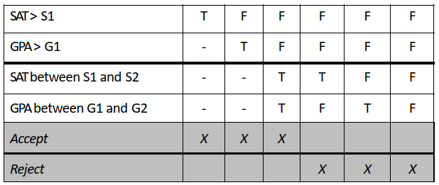
Decision Table Model
University Admission Decision
Each column is a separate decision case. The columns are processed from left to right.
Note that the rules are specific and testable.

Slide 65
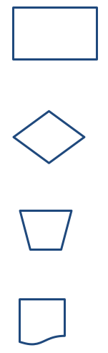
Flowchart Model
An informal modeling technique to show the logic of part of a system and paths that data takes through a system.
Operation
Decision
Manual operation
Report

Slide 66
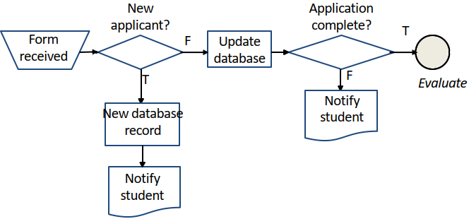
Flowchart Model (cont.)
Example: University Admissions Assemble Application
Compare this example, which shows the logic,
with the dataflow model, which shows the flow of data.

Slide 67
Modeling Tools: Pseudo-code
The notation used for pseudo-code can be informal, or a standard used by a software development organization, or based on a regular programming language. What matters is that its interpretation is understood by everybody involved.

Slide 68
Modeling Tools: Pseudo-code (cont.)
Example: University Admission Decision
Admin_decision (application)
if application.SAT == null then error (incomplete)
if application.SAT > S1 then accept (application)
else if application.GPA > G1 then accept (application)
else if application.SAT > S2 and application.GPA > G2
then accept (application)
else reject(application)

Slide 69
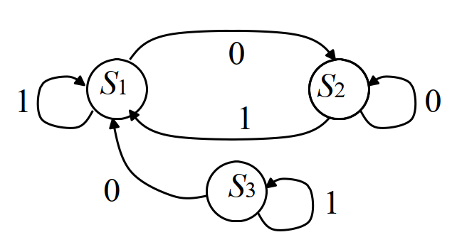
Modeling Tools: Transition Diagrams
A system is modeled as a set of states, Si
A transition is a change from one state to another.
The occurrence of a condition, Ci, causes the transition from one state to another
Transition function: f (S_{i}, C_{j}) = S_{k}

Slide 70
Finite State Machine Model Therapy Control Console
Example: Radiation Therapy Control Console
You are developing requirements for the operator's control console. In an interview, the client describes the procedures that the operator must follow when operating the machine.
You use a ﬁnite state machine model to specify the procedures.
This shows the client that you understand the requirements and speciﬁes the procedures for the developers.

Slide 71
Finite State Machine Model Therapy Control Console (cont.)
The client provides the following rough scenario.
The set up is carried out before the patient is made ready. The operator selects the patient information from a database. This provides a list of radiation ﬁelds that are approved for this patient. The operator selects the ﬁrst ﬁeld. This completes the set up.
The patient is now made ready. The lock is taken oﬀ the machine and the doses with this ﬁeld are applied. The operator then returns to the ﬁeld selection and chooses another ﬁeld.

Slide 72
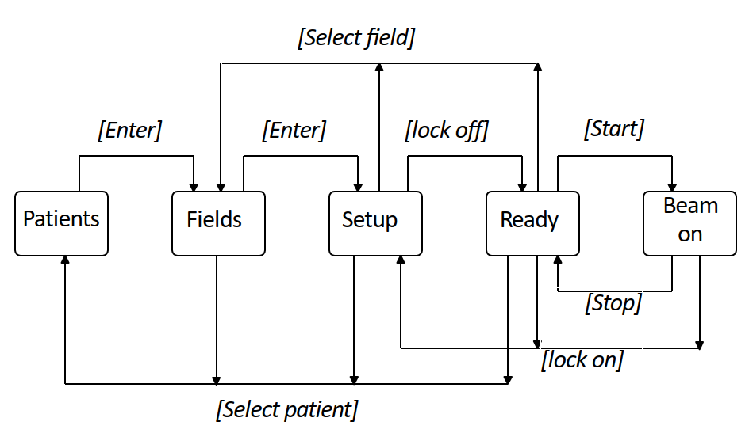
Finite State Machine Model Therapy Control Console (cont.)

Slide 73
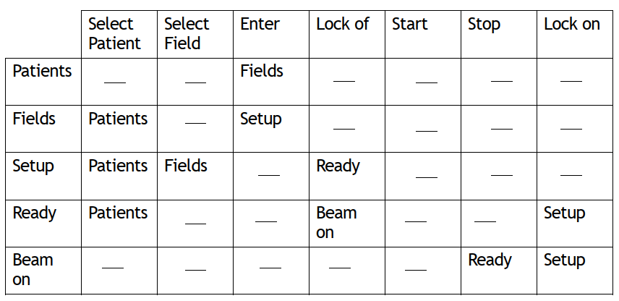
Finite State Machine Model State Transition Table
This table can be used for requirements deﬁnition, program design, and acceptance testing.

Slide 74
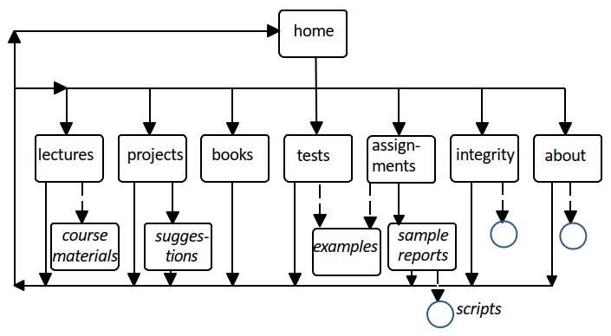
Finite State Machine Model
Example: Department Website

Slide 75
Entity-Relation Model
A requirements and design methodology for relational databases
A database of entities and relations
Tools for displaying and manipulating entity-relation diagrams
Tools for manipulating the database (e.g., as input to database design)
Entity-relationship models can be used both for requirements speciﬁcation and for the design speciﬁcation.

Slide 76
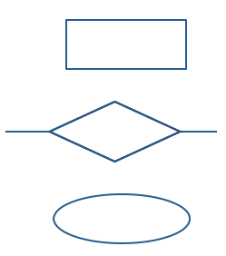
Entity-Relation Model (cont.)
An entity (noun)
A relation between entities (verb)
An entity or relation attribute

Slide 77
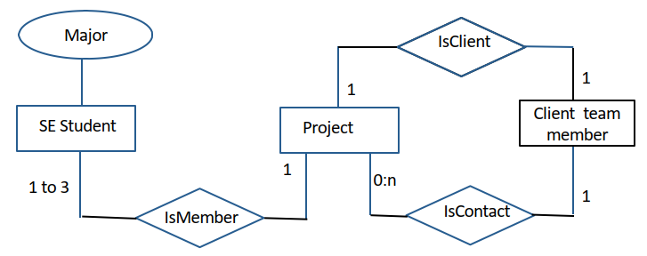
Entity-Relation Model (cont.)
Example: SE Project

Slide 78
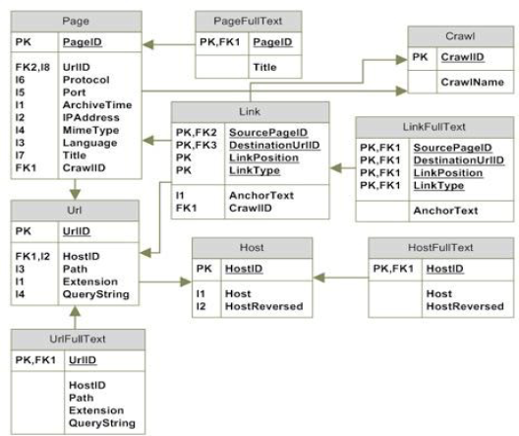
Entity-Relation Model (cont.)
Example: Database Schema for Web Data
Notation: Each table represents an entity. Each arrow represents a relation

Slide 79
Prototyping Requirements
Rapid prototyping is the most comprehensive of all modeling methods
A method for specifying requirements by building a system that demonstrates the functionality of key parts of the required system
Particularly valuable for user interfaces

Slide 80
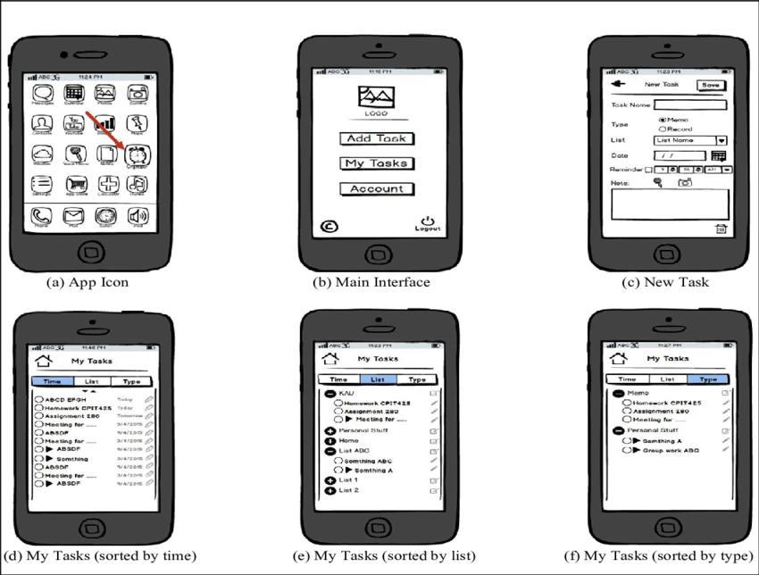
Prototyping Requirements

